Slide 1

Management Accounting
Instructor:
Prof. Dr.B. Gültekin Çetiner
Website: http://elearning.drcetiner.com
Contact: drcetiner@gmail.com
drcetiner@gmail.com Dr. B. Gultekin Cetiner

Slide 2
IE454
Cost Analysis
Textbook:
Management Accounting for Business, Colin Drury, 3rd Edition,
Thomson Learning, 2005
drcetiner@gmail.com Dr. B. Gultekin Cetiner

Slide 3
Management Accounting
2000 Catalog :
The course is designed for those who are interested in developing an understanding of the costs and expenses related to manufacturing, retail, and service businesses, a knowledge of the information system structures available for manufacturing enterprises and the classifications of costs and expenses and their relationships to profits, skills for presenting financial information to facilitate decision making.
drcetiner@gmail.com Dr. B. Gultekin Cetiner

Slide 4
Contents
1 Introduction to Costing, Management Accounting
2 An introduction to cost terms and concepts
3 Cost-volume-profit analysis
4 Measuring relevant costs and revenues for decision-making
5 Cost assignment
6 Activity based costing
7 Pricing decisions and profitability analysis
8 Decision-making under conditions of risk and uncertainty
9 Capital investment decisions
10 The budgeting process
11 Management control systems
12 Standard cosing and variance analysis
13 Divisional financial performance measures
14 Transfer pricing in divisionalized companies
15 Cost management
16 Strategic management accounting
drcetiner@gmail.com Dr. B. Gultekin Cetiner

Slide 5
Definition and Users of Accounting
Definition of accounting
the process of identifying,measuring and communicating economic information to permit informed judgements and decisions by users of the information.
Users of accounting information can be divided into two categories:
(i) External parties outside the organization (financial accounting).
(ii) Internal parties within the organization (management accounting).
drcetiner@gmail.com Dr. B. Gultekin Cetiner

Slide 6
Stakeholders of Accounting
Managers (Internal Users)
Shareholders (External Users)
Potential Investors (External Users)
Creditors (External Users)
Employees (Internal Users)
Government (External Users)
drcetiner@gmail.com Dr. B. Gultekin Cetiner

Slide 7
Differences between Management Accounting and Financial Accounting
Legal Requirements
Focus on individual parts or segments of business
Generally Accepted Accounting Principles
Time Dimension
Report Frequency
drcetiner@gmail.com Dr. B. Gultekin Cetiner

Slide 8
Decision-Making Process
Decision Making: Process of making a conscious choice between
2 or more alternatives producing most desirable consequences
(benefits) relative to unwanted consequences (costs).
Decision Making is essential part of Planning
Planning: Decision in advance what to do, how to do, when to
do and who is to do it.
drcetiner@gmail.com Dr. B. Gultekin Cetiner

Slide 9
Objective versus Bounded Rationality
A Decision is objectively rational if it is the correct behavior for
maximizing given values in a given situation.
Rationality requires
A complete knowledge and anticipations of consequences
after a choice
Imagination since Consequences lie in future
A choice among all possible alternatives.
We can only talk about bounded rationality
drcetiner@gmail.com Dr. B. Gultekin Cetiner

Slide 10
Objective versus Bounded Rationality
Objective Rationality looks for the ‘best’ solution whereas Bounded Rationality looks for the ‘good enough’ solution.
drcetiner@gmail.com Dr. B. Gultekin Cetiner

Slide 11
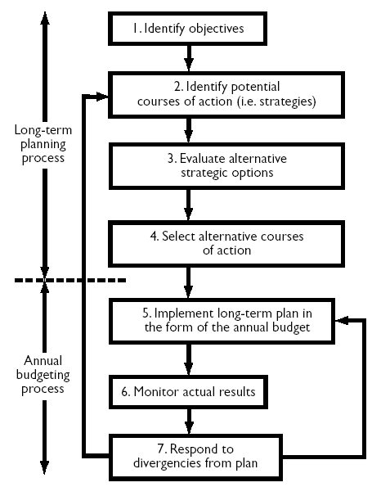
Decision-making, planning and control process
An overview of the planning process
1. Identify the objectives of the organization.
2. Identify potential strategies.
3. Evaluate alternative strategic options.
4. Select course of action.
5. Implement the long-term plan in the form of the annual budget.
6. Monitor actual results.
7. Respond to divergencies from plan.
drcetiner@gmail.com Dr. B. Gultekin Cetiner

Slide 12
The changing business environment
Organizations have faced dramatic changes in their business environment.
• Move from protected markets to highly competitive global markets
• Deregulation
• Declining product life-cycles
drcetiner@gmail.com Dr. B. Gultekin Cetiner

Slide 13
To compete successfully in today’s environment
To compete successfully in today’s environment
companies are:
• Making customer satisfaction an overriding priority.
• Adopting new management approaches.
• Changing their manufacturing systems.
• Investing in AMT ’s.
Above changes are having a significant impact on the MAS.
drcetiner@gmail.com Dr. B. Gultekin Cetiner

Slide 14
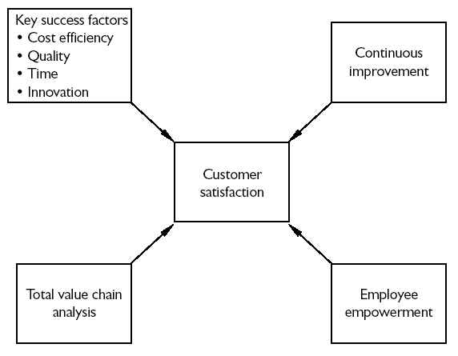
Focus on Customer Satisfaction
drcetiner@gmail.com Dr. B. Gultekin Cetiner

Slide 15
Focus on Customer Satisfaction
Key success factors
• Cost efficiency –increased emphasis on accurate product costs and cost management.
• Quality –TQM,quality measures.
• Time – educed cycle time,focus on non-value-added activities.
• Innovation – responsiveness in meeting customer requirements.
Product comparisons.
Feedback on customer satisfaction.
drcetiner@gmail.com Dr. B. Gultekin Cetiner

Slide 16
Focus on Customer Satisfaction
Continuous improvement
• Static historical standards no longer appropriate.
Benchmarking.
Employee empowerment
• Delegate more responsibility to people closest to operating processes and customers.
Value chain analysis
• Suppliers,R &D,design,production,marketing, distribution,customer service,customers.
Internal customer perspective.
Social responsibility and corporate ethics
drcetiner@gmail.com Dr. B. Gultekin Cetiner

Slide 17
International convergence of management accounting
Management accounting practices can be observed at the macro or micro levels:
• Macro refers to concepts and techniques
• Micro refers to the behavioral patterns of use.
Tendency towards globalization at the macro level
drcetiner@gmail.com Dr. B. Gultekin Cetiner

Slide 18
International convergence of management accounting
Drivers of convergence include:
• Global competition
• Information technology (e.g. ERP systems)
• Standardization by transnational companies
• Global consultancy
• Use of global textbooks
At the micro level accounting information may be used in different ways due to influence of different national and local cultures
drcetiner@gmail.com Dr. B. Gultekin Cetiner

Slide 19
Primary functions of cost/management accounting systems
Inventory valuation for internal and external profit measurement
• Allocate costs between products sold and fully and partly completed products that are unsold.
Provide relevant information to help managers make better decisions
• Profitability analysis
• Product pricing
• Make or buy (Outsourcing)
• Product mix and discontinuation
drcetiner@gmail.com Dr. B. Gultekin Cetiner

Slide 20
Primary functions of cost/management accounting systems
Provide information for planning,control and performance measurement
• Long-term and short-term planning (budgeting)
• Periodic performance reports for feedback control
• Performance reports also widely used to evaluate managerial performance
• Note that costs should be assembled in different ways to meet the above three requirements.
drcetiner@gmail.com Dr. B. Gultekin Cetiner

Slide 21
Brief Historical Description of management accounting
Most of management accounting practices that were in use in the mid-1980s had been developed by 1925.
There was a halt for the next 60 years.
After strong criticisms of practices which were obsolete due to changing competitive business environments, the techniques were either modified or new techniques have been developed.
These techniques are used now in today’s business environments.
drcetiner@gmail.com Dr. B. Gultekin Cetiner

